Slide 1
Introducing Convolutional Neural Network

Slide 2
Hello!
I am Muhammad Ali Murtaza

Slide 3
AGENDA
Computer Vision
Edge Detection
What does mean learning
Padding and Stride
Start Playing with filters
Number of Parameters
Notations
Types of Layers
Res-Net Example
Summary of Res-Net Model
Benefits of Convolutions

Slide 4
Computer Vision
1

Slide 5

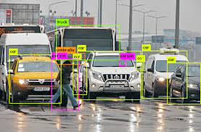
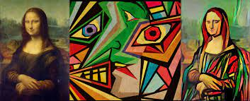
Computer Vision
1
Definition
Computer vision enables the machine to extract meaningful information form visual inputs like image, video ,etc.
Motivation of CV
Rapid change in the industry.
Face Recognition Attendance System
Safe City
Other industries taking interest in the research and methods of cv invented like CNN is using for speech recognition.
Examples of CV
Cat Detection
Object Detection
Neural Style Transfer

Slide 6
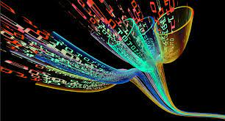
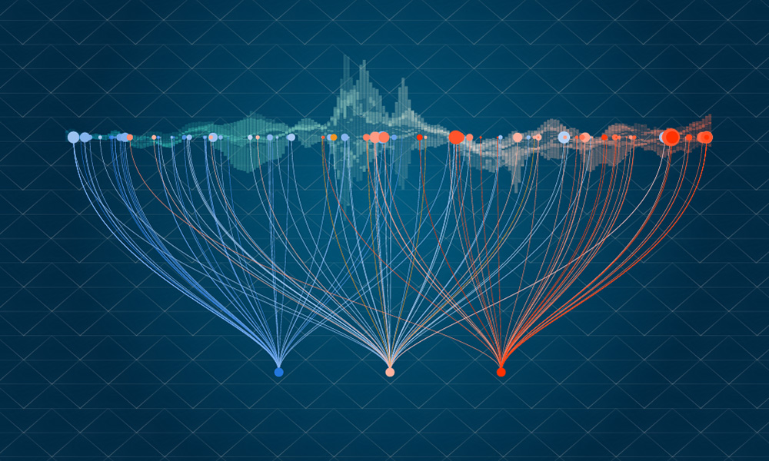
Challenges of Computer Vision
Expensive Computation
For some accurate model training, large amount of data required

Slide 7
First Understand the Concept of Dimentions

Slide 8
Multiple Dimensions
Understand some basic dimensions and their notations.
1
3
3x3
3x3x3

Slide 9



Scary Images
These are some images that scares you.

Slide 10
Let’s Start with Simple Concepts

Slide 11
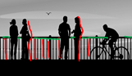

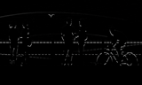
Edge Detection
A simple RGB Image containing some information
Vertical Edges Detection
Horizontal Edges Detection
Highlighting objects have vertical appearance
Highlighting objects have horizontal appearance

Slide 12
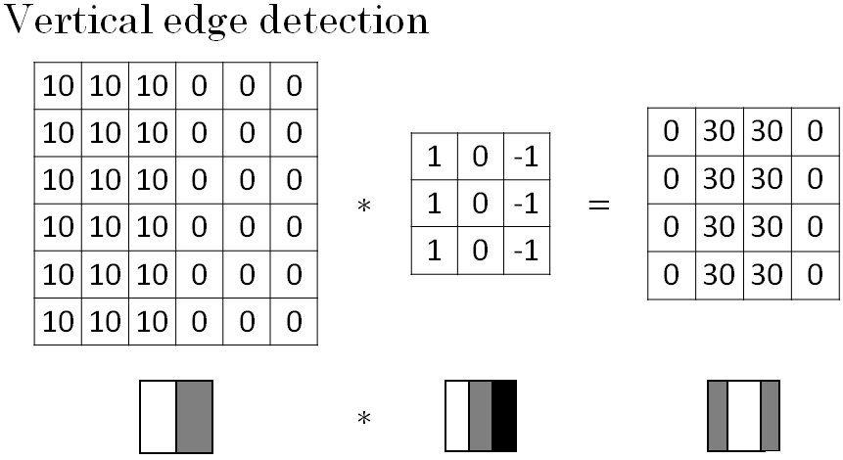
How Edge Detection Works

Slide 13

How filter applying on Image

Slide 14

Padding
Padding is the extra spaces added on siding of actual image.
Padding addition due to avoidance of image shrinking
Result in a Convolved image of same shape before convolution called “Same Convolution”.

Slide 15
Stride
Stride is the count which filter steps during convolution.
It highly affects the size and shape of Convolved Image.
Provided image following stride of 2.
Smaller stride causes greater computation in convolution.

Slide 16
Congratulations !
You have learnt all basic blocks of the actual game (CNN)

Slide 17
Now Start Playing with filters

Slide 18
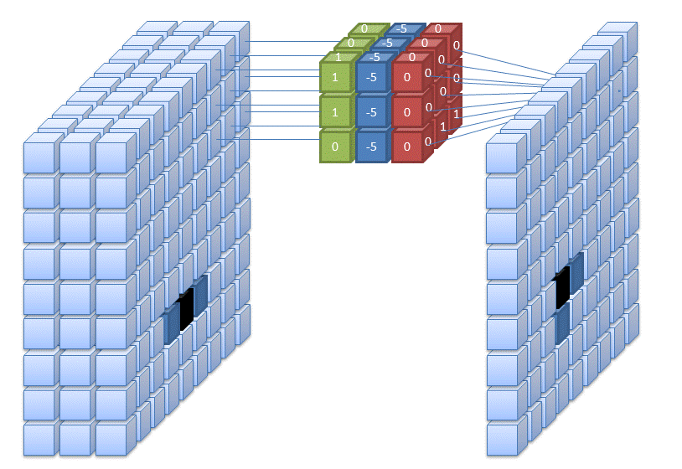
Single Filter Convolution
Convolution applying on RGB image.
Filter channels are according to RGB image.
RGB Convolution result in a single channel convolved image.
Each channel of filter are applied on respective channel of input image.

Slide 19
Multiple Filter Convolution
*
=
First 3 Channel filter applied causes 1 channel in convolved image
*
Single RGB Image of shape
(6x6x3)
Second 3 Channel filter applied causes 1 more channel in convolved image
Two filter applied on single image creates two channels in resultant image

Slide 20
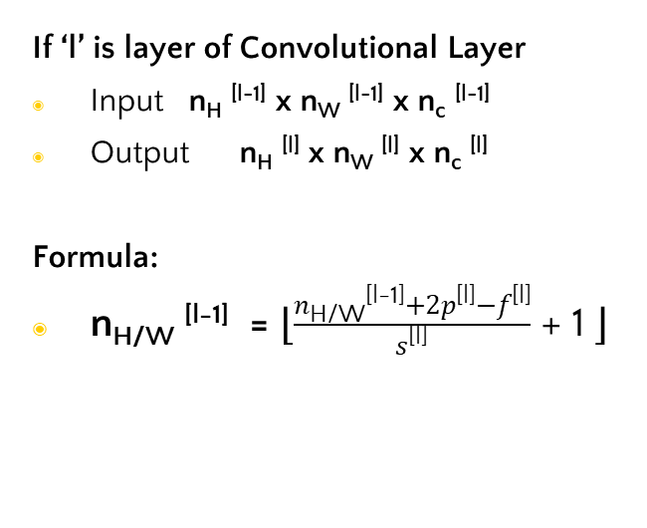
Some Notations and Formulas
If ‘l’ is layer of Convolutional Layer
f ^{[l]} = filter size
p ^{[l]} = padding size
s ^{[l]} = stride
n_{c}^{[l]} = Number of Filters
If ‘l’ is layer of Convolutional Layer
Input n_{H} ^{[l-1]} x n_{W} ^{[l-1]} x n_{c} ^{[l-1]}
Output n_{H} ^{[l]} x n_{W} ^{[l]} x n_{c} ^{[l]}
Formula:
n_{H/W} ^{[l-1]} = ⌊$\frac{n\text{H}\text{/}\text{W}\text{[}\text{l}\text{−1}\text{]}+2p\text{[}\text{l}\text{]}−f\text{[}\text{l}\text{]}}{s\text{[}\text{l}\text{]}}$ + 1 ⌋

Slide 21
Practice Question for Number of Parameters
If you have 10 filters that are 3 x 3 x 3 in one layer of a neural network, how many parameters does that layer have?
ANS: 280

Slide 22

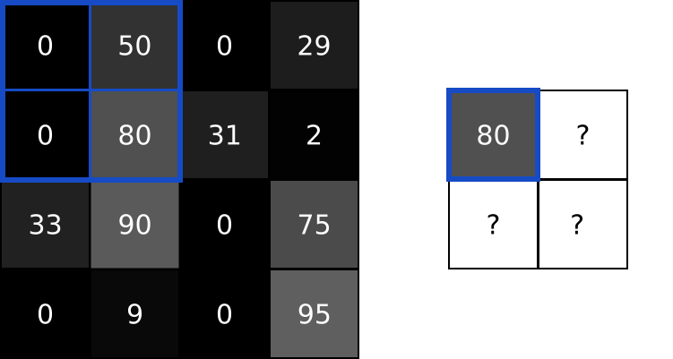
Some more type of Layers
Pooling Layer
Pooling layer provides the approach to down sample the feature map by summarizing the presence of feature.
It is a constant layer, means that no learning occur in this layer.
Different type of Pooling layers are available like MAX POOL, MIN POOL, AVG POOL, etc.
Fully Connected Layer
Fully connected layer means all possible connections layer-to-layer are present.
It result in a very expensive computation.
This layer contributes in learning of the model.

Slide 23
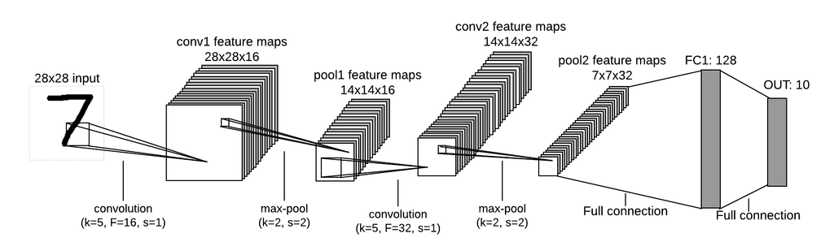
Model Example

Slide 24
Res-Net 5 Model Example
 | Activation Shape | Activation Size | # parameters
Input: | (32, 32, 3) | 3,072 | 0
CONV1(f=5,s=1) | (28,28,8) | 6,272 | 608
POOL1 | (14,14,8) | 1,568 | 0
CONV2(f=5,s=1) | (10,10,16) | 1,600 | 3,216
POOL2 | (5,5,16) | 400 | 0
FC3 | (120, 1) | 120 | 48,120
FC4 | (84,1) | 84 | 10,164
Softmax | (10, 1) | 10 | 850

Slide 25
Some Benefits of Convolution
Parameter Sharing
A feature detector (such as a vertical edge detector) that’s useful in one part of the image is probably useful in another part of the image.
Sparsity of Connections
In each layer, each output value depends only on a small number of inputs.

Slide 26
Thanks!
Any questions ?

